Slide 1
AIR QUALITY ANALYSIS AND PREDICTION IN TAMILNADU

Slide 2
CONTENT
ABSTRACT
AIR ANALYSIS CODES
AIR PREDICTION ARCHITECTURE
AIR QUALITY MONITORING STATION [AQMS]
ANALYSIS AND PREDICTION OF AIR QUALITY GRAPH

Slide 3
ABSTRACT
AIR POLLUTION LEVEL
The prediction model is validated and evaluated by statistical calculations, and then it was found that it performed well in the prediction of PM2.5.
The quality of air in Alandur, Chennai is polluted by Particulate Matter (PM2.5) over the years. Reports prove that particulates affect the health of humans and environment.
PREDICTION WORK
Air quality monitoring data are used to check the concentration with the ambient air quality standards provided by the government. The purpose of prediction is to develop effective emission control strategies and also helps to find the contribution of each source causing pollution.

Slide 4
AIR ANALYSIS CODES
import matplotlib.pyplot as plt
from matplotlib.animation import FuncAnimation
import random
# Generate some sample air quality data (replace with your own data)
timestamps = range(1, 11)
pm25_values = [random.randint(0, 50) for _ in timestamps]
# Initialize the plot
fig, ax = plt.subplots()
ax.set_xlim(1, 10)
ax.set_ylim(0, 50)
line, = ax.plot([], [], lw=2)
# Function to update the animation at each time step
def animate(i):
line.set_data(timestamps[:i], pm25_values[:i])
return line,
# Create the animation

Slide 5
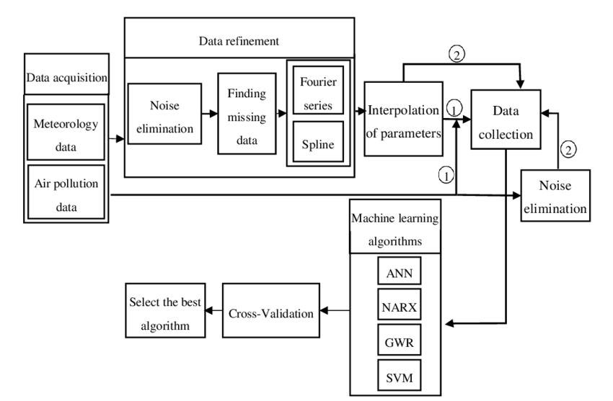
AIR PREDICTION ARCHITECTURE
BLOCK DIAGRAM

Slide 6
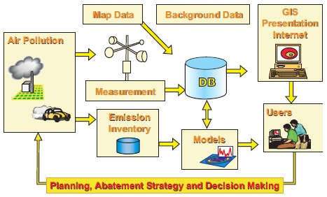
AIR QUALITY MONITORING STATION [AQMS]

Slide 7
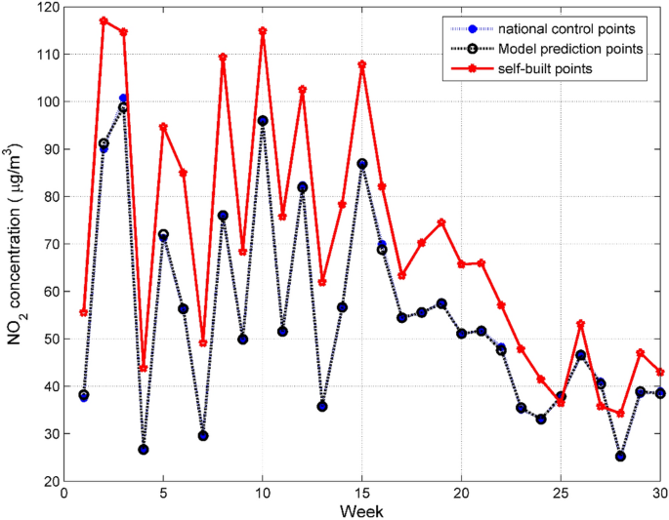
ANALYSIS AND PREDICTION OF AIR QUALITY
GRAPH

Slide 8
THANK YOU

